Slide 1
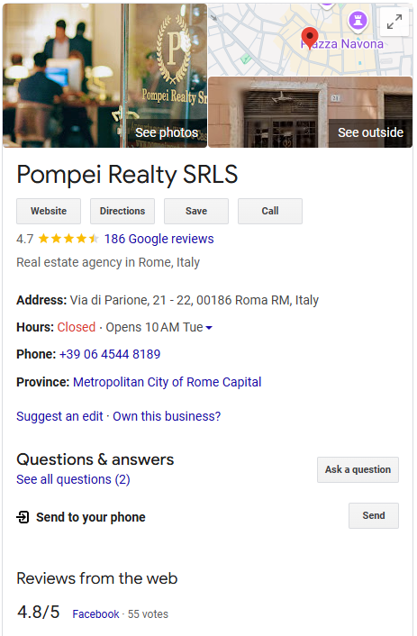
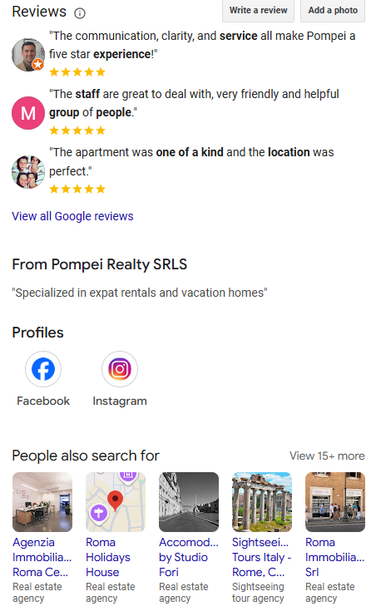
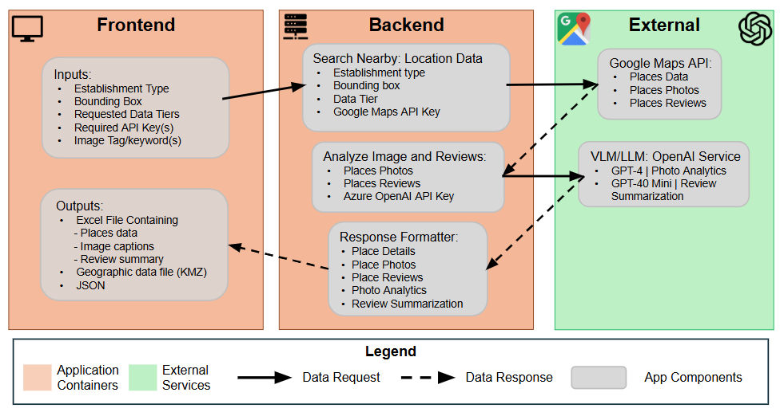
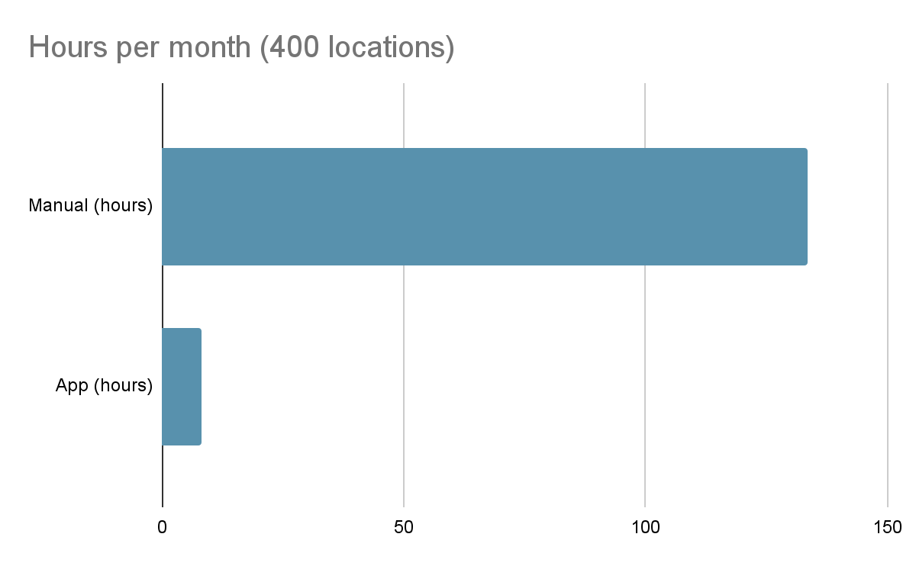
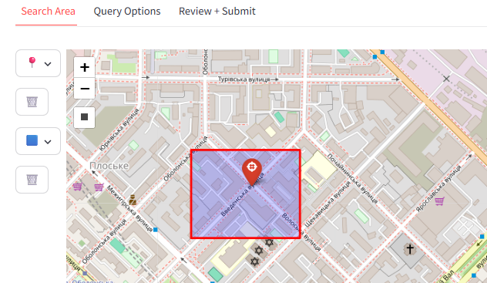
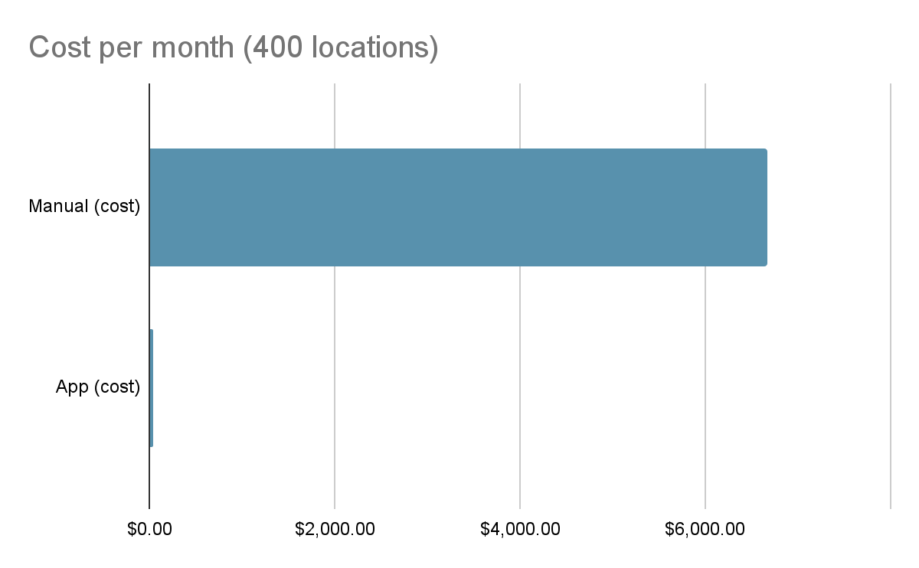
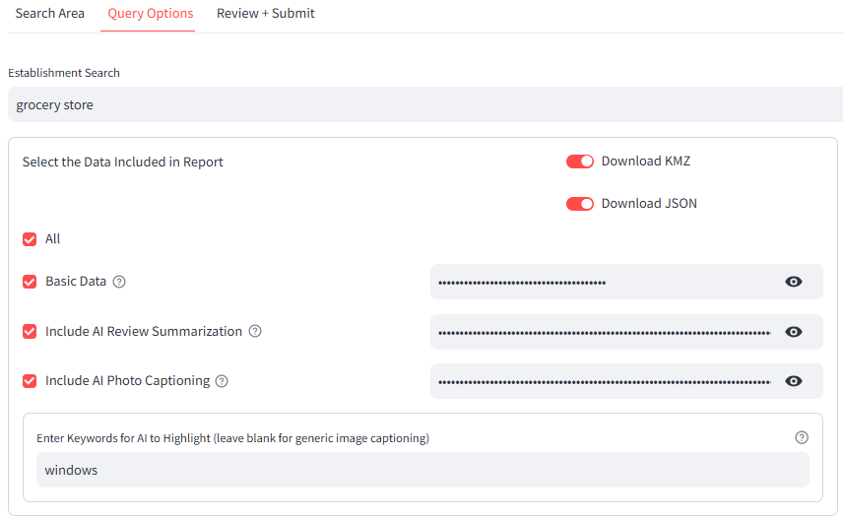
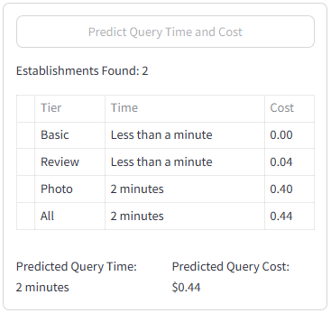
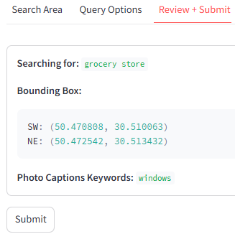
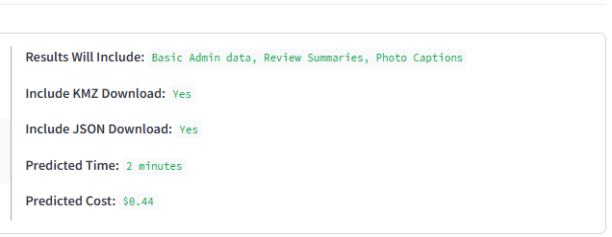
Tactical OPE Toolkit -
Automating Location Intelligence for Special Operations Using AI
Supervisor - Eric Youn and Zach Murphy AI Technicians 2024-2025 - Capstone Project
Gregory McDonald
AI2C - gmcdonal@andrew.cmu.edu
Haldon Franko
AI2C -hfranko@andrew.cmu.edu
Jeff Noland
AI2C- jnoland@andrew.cmu.edu
Maksym Kalinchenko
AI2C -mkalinch@andrew.cmu.edu
Sang Yim
AI2C - smyim@andrew.cmu.edu
Zachary Andersen
AI2C - zacharya@andrew.cmu.edu
1. Background & Motivation
2. Problem Statement
The Special Operations Forces (SOF) conducts worldwide special operations, often in denied or restricted territory. Understanding the operational environment is essential, and the SOF analysts provide situational awareness through detailed analysis, which supports mission planning and execution. While civil considerations can often be gathered through tools like Google Maps, there is currently no automated method to efficiently extract and analyze this information.
How can we retrieve location details from Google Maps and generate an Excel, with image analysis and review summarization to enable operational planning and execution while reducing the man hours and cost?
3. Current Solution
Manual Process Overview
Open Google Maps and select the location
Copy and paste the data into the Excel file
Triage the reviews and photos; author a summary
Highlight key features in reviews and photos
20 min process time per locations
8 - 40 hours to complete each report
Missions require a 24 hour turn around
Estimated 400 locations per month = 133.3 hours
4. Solution Design
6. Impact
133.3
hours
8.3
hours
5. Application Implementation
94% reduction in schedule; saving 125 hours per month
Searching
Drop pins
Draw bounding box
Add bounding box
$6,666
$37
Querying
99.4% reduction in cost; saving $6,629 per month
7. Key Takeaways
Establishment search term
Data tiers (basic, review, photos)
Outputs (Excel, KMZ, and JSON)
API key handling
Photo captioning keywords
Time and cost prediction
Reduction of 94% in schedule and 99.4% in cost
Reduced the risk of human error
Automated Excel generation
Additional outputs: KMZ and JSON
More information: AI summarized reviews & photos
Accessible via the cloud or local host
Validating
For more information on the Tactical OPE Toolkit including a demonstration video and documentation - use the QR code

